Slide 1
Zero Trust Architecture for Securing PLC-HMI Communication in Industrial Control Systems
mTLS-Based Proxy Design, Policy Enforcement, and Empirical Attack Validation

Slide 2
Legacy OT networks lack native security, leaving physical processes highly vulnerable.
Protocol Design Flaws
Operational technology (OT) networks were originally engineered for determinism and availability, not confidentiality. The Modbus protocol operates entirely without native authentication, encryption, or integrity verification.
Any host reaching port 502/TCP on a PLC can issue arbitrary read or write commands without requiring credentials.
~90%
Global Infrastructure
Estimated deployment of the Modbus protocol across industrial automation systems worldwide.
Highlighted Real-World Incidents
2021 Oldsmar Water Treatment Incident: Unauthorized alteration of chemical levels via exposed control interfaces.
2015 & 2016 Ukrainian Power Grid Attacks: Direct cyber intrusions exploiting unauthenticated industrial protocols to cause widespread blackouts.

Slide 3
Current security methods fail to provide deterministic, per-identity access control without prohibitive costs.
Segmentation Vulnerabilities
Network-Layer Segmentation
Fails to mitigate threats against authorized but compromised hosts once network boundaries are traversed.
Upgrade Barriers
Protocol Replacement (e.g., OPC-UA)
Provides native security but demands extensive firmware upgrades that are often prohibitive for older brownfield facilities.
Detection Limitations
Anomaly Detection Approaches
Cannot deterministically block zero-day write injections; frequent false positives carry high operational costs.
Financial & Functional Constraints
Commercial Inline Security Appliances
Typically lack granular per-identity access control while imposing capital costs ranging from $3,000 to $15,000 per choke point.

Slide 4
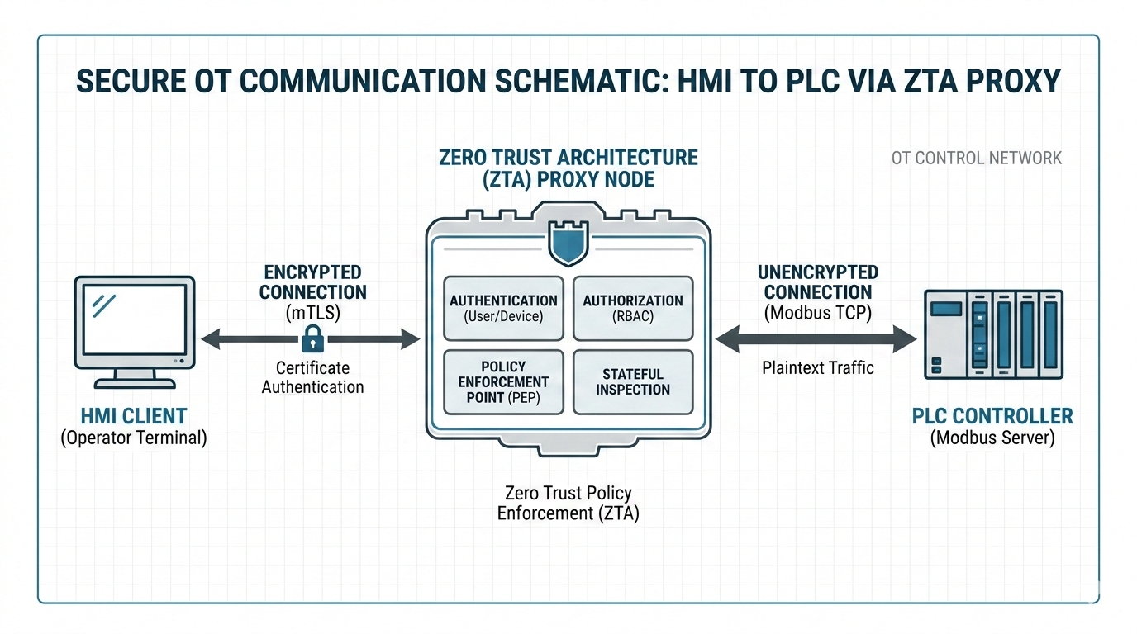
A non-intrusive ZTA proxy enforces authentication and write-blocking without firmware changes.
System Architecture & Mechanics
Transparent Proxy Implementation
The proposed system interposes a Python-based transparent proxy between the human-machine interface (HMI) and the programmable logic controller (PLC).
The proxy binds to port 5020, while direct access to port 502 is strictly restricted by host firewall rules.
It enforces mutual Transport Layer Security (mTLS) with X.509 certificate authentication on the HMI-facing port and forwards only policy-compliant Modbus application data units to the controller, requiring zero changes to existing PLC firmware.
Key Security Enforcement
mTLS + X.509 Certificate Auth (Port 5020) → ZTA Policy Engine → Modbus TCP Forwarding (Port 502)

Slide 5
The deterministic policy engine eliminates the write-injection surface by strictly whitelisting read operations.
WHITELISTED READ OPERATIONS (PERMITTED)
BLOCKED WRITE OPERATIONS (RESTRICTED)
The proxy strictly permits read-only function codes to ensure total operational visibility without write risk:
FC01: Read Coils
FC02: Read Discrete Inputs
FC03: Read Holding Registers
FC04: Read Input Registers
All write-class function codes are intercepted and blocked immediately to prevent unauthorized state changes:
FC05: Write Single Coil
FC06: Write Single Register
FC0F: Write Multiple Coils
FC10: Write Multiple Registers
DETERMINISTIC POLICY ENGINE SPECIFICATIONS
Operates with a formally bounded decision latency of under 50 µs. Unauthorized function codes immediately receive a Modbus exception response, deterministically eliminating write-injection vectors without probabilistic anomaly detection.

Slide 6
mTLS with X.509 certificates ensures per-session authentication and forward secrecy.
1
2
3
3-Tier PKI & Issuance
The architecture relies on a three-tier Public Key Infrastructure (PKI) generated using OpenSSL 3.0.2.
Component certificates are issued for the proxy server and authorized HMI clients.
TLS Handshake Verification
The proxy enforces a minimum protocol version of TLS 1.2.
Requires a CA-signed client certificate before any Modbus byte is transmitted.
ECDHE Key Exchange
The TLS handshake employs ECDHE key exchange, providing forward secrecy by using ephemeral session keys.
Renders captured ciphertext completely undecipherable.
SECURITY ENFORCEMENT SUMMARY
Strict Mutual Authentication
By terminating TLS at the proxy and enforcing client certificate validation before Modbus payload processing, unauthorized traffic is filtered at the transport layer.
HMI CLIENT
X.509 Cert
mTLS 1.2
ZTA PROXY
ECDHE Validation
MODBUS
MODBUS

Slide 7
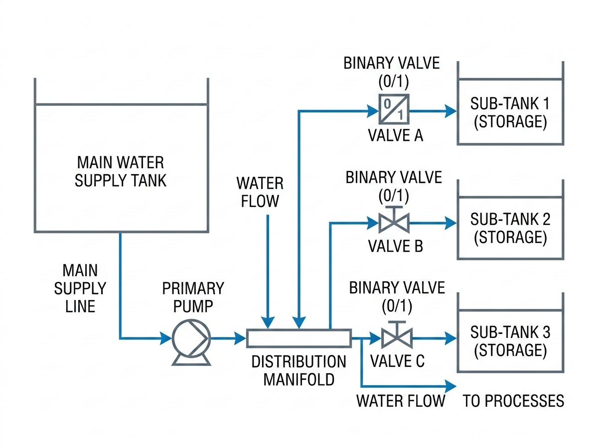
The ZTA proxy was validated on an open-source, hardware-in-the-loop water distribution testbed.
PHYSICAL PROCESS SIMULATION
The experimental system models a water distribution process featuring a main supply tank and three sub-tanks controlled by binary valves.
RUNTIME ENVIRONMENT & CONTROL
The PLC program executes via OpenPLC Runtime v3.0 under IEC 61131-3 Structured Text on an Ubuntu 22.04 LTS virtual machine. Fluid transfer is modeled at a nominal rate of 0.4 units per 100 ms cycle.
OPEN-SOURCE REPRODUCIBILITY
The testbed, certificates, proxy, and attack scripts are entirely open-source.
FIGURE 1: WATER DISTRIBUTION SYSTEM ARCHITECTURE

Slide 8
The system was rigorously evaluated against five distinct attack categories mapped to STRIDE.
Evaluated STRIDE Threat Scenarios
Adversary Model & Setup
Host Specification & Capabilities
The adversary is modeled as a host with TCP/IP reachability to the OT network.
Possesses domain knowledge of Modbus TCP protocol specifications and the target PLC register map.
The evaluation utilized standard penetration-testing tools across five distinct threat scenarios.
Valve force
Category: Tampering | Target: FC05
Sensor spoof
Category: Tampering | Target: FC10
Supply drain
Category: DoS | Target: FC06
Multi-vector
Category: Tampering + DoS | Target: Multiple FCs
Replay
Category: Repudiation | Target: Any FC

Slide 9
Unprotected Modbus TCP configurations are entirely susceptible to unauthorized command injection.
100%
Attack Success Rate (Baseline)
Executed Threat Vectors (5/5 Successful)
1. Forced Coil Outputs
Attackers successfully issued unauthorized commands to force digital coil state outputs across the network.
2. Overwrote Holding Registers
Overwrote critical holding registers with fabricated telemetry, compromising system visibility and operational accuracy.
3. Halted Valve Actuation
Successfully drained the supply register, causing physical disruption by halting active valve actuation.
4. Replayed Raw Commands
Executed unauthenticated replayed raw Modbus TCP commands without triggering protocol-level rejections.
Observation Details
Captured 74,896 Modbus/TCP frames in cleartext during a 4-hour observation window with zero protection.
Vulnerability Summary
In the baseline unprotected configuration, all Application Data Units (ADUs) are transmitted in cleartext, rendering the system entirely open to malicious exploitation.

Slide 10
The ZTA-enabled configuration successfully blocked 100% of all tested attack classes.
100%
BLOCK RATE ACROSS ALL THREATS
Comprehensive protection against all STRIDE attack categories
TLS HANDSHAKE LAYER
Unauthenticated Access
Unauthenticated connections were rejected at the TLS handshake layer before reaching the PLC.
POLICY ENGINE
Stolen Certificates
Attacks using valid stolen certificates were blocked by the policy engine.
SUMMARY EVALUATION
The ZTA proxy achieved a 100% block rate across all threats, demonstrating robust multi-layered perimeter defense and cryptographic verification for industrial control systems.
EPHEMERAL SESSION KEYS
Replay Attacks
Replay attacks failed because TLS session keys are ephemeral, preventing injection of captured ciphertext.
NETWORK CAPTURE
Encrypted Protocols
Network captures confirmed traffic appeared exclusively as encrypted TLS Application Data records.

Slide 11
The ZTA proxy introduces negligible latency overhead while maintaining high system availability.
+2.3 ms
Mean Added Latency
0.46%
Control Loop Impact
98.6%
System Availability
Latency Performance
Transaction & Scan Overhead
Mean per-transaction latency increased by only 2.3 ms, rising from a baseline of 1.4 ms to 3.7 ms.
For a control loop executing at a 500 ms scan interval, this overhead represents just 0.46% of the interval, which is operationally negligible.
Reliability & Uptime
Observation Window Metrics
System availability remained high at 98.6% over a 14,400-cycle observation window.
Crucially, zero timeout events were attributable to ZTA security processing, demonstrating consistent stability under operational workloads.

Slide 12
The proposed ZTA provides cost-free security, with future work targeting sub-100 ms loops.
CORE CAPABILITIES
Advantages Over Legacy Options
mTLS & Encryption: Provides mutual authentication and robust data encryption unlike OPC-UA or cleartext protocols.
Granular Policy Control: Implements per-ID and function-code policy enforcement directly at the proxy level.
Zero Firmware Changes: Operates seamlessly without requiring updates or modifications to PLC firmware.
Cost-Free Deployment: Avoids high capital expenditures associated with commercial firewalls.
PERFORMANCE OPTIMIZATION
Compiled Rust Implementation
Reduces proxy overhead to achieve sub-100 ms scan intervals for rapid industrial control loops.
ENTERPRISE VISIBILITY
SIEM Platform Integration
Integrates proxy audit logs directly with SIEM platforms for centralized threat analysis and monitoring.
MATHEMATICAL VERIFICATION
Formal Logic Guarantees (TLA+)
Utilizes formal verification tools like TLA+ to mathematically guarantee policy engine logic.

